Slide 1
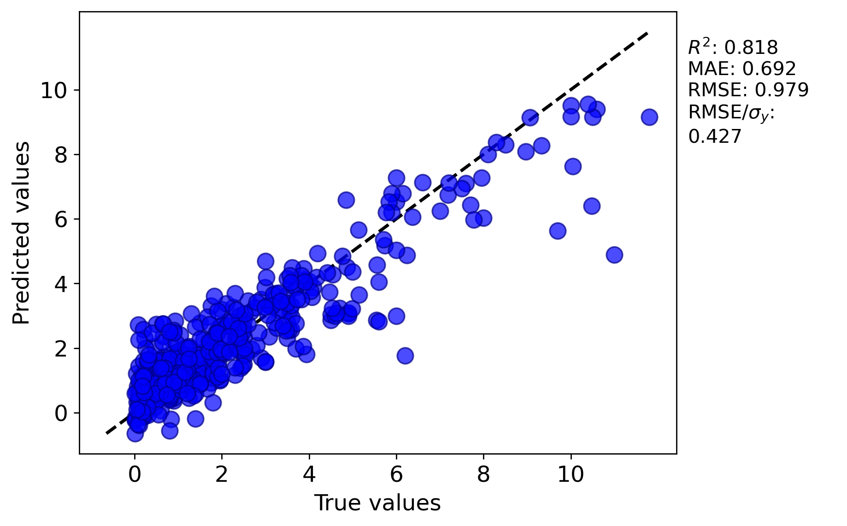
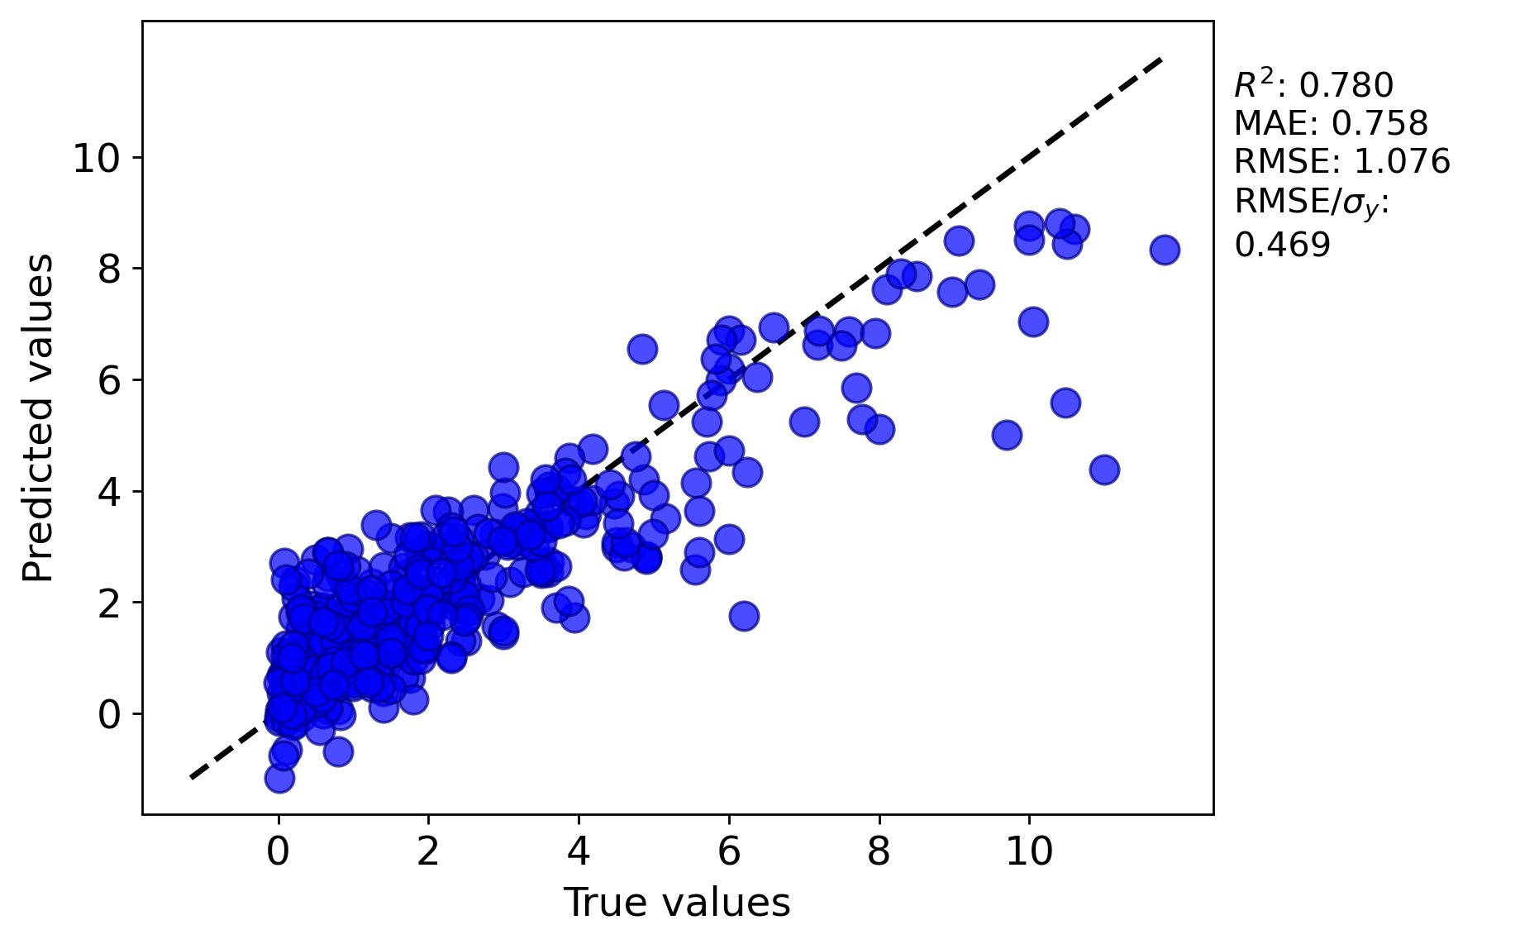
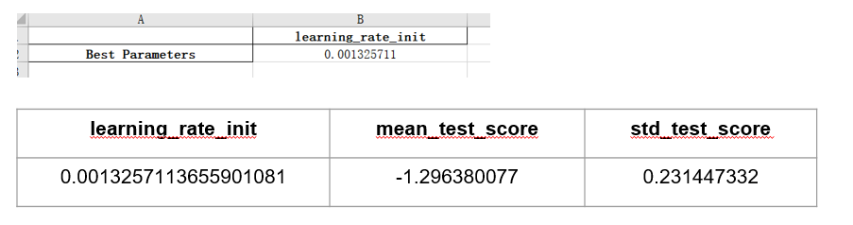
Assessment Figures

Slide 2
ML4ER Assignment 6
Jiahui Yang
Informatics Skunkworks
MSE 401, 3 Credits
Aug 11 2024

Slide 3

Progress
Your best trained model at predicting the spiral data from the NN playground activity (also report the error metrics!)
learning_rate_init | mean_test_score | std_test_score
0.0013257113655901081 | -1.296380077 | 0.231447332

Slide 4
Progress
Your parity plot of Test data for the best hyperparameters you found before changing the model neuron structure
This scatter plot shows predicted values versus true values, with an R² of 0.818, MAE of 0.692, RMSE of 0.979, and RMSE/σᵧ of 0.427.

Slide 5

Progress
The same thing after modifying neuron structure
hidden_layer_sizes | mean_test_score | std_test_score
100 | -1.334484359 | 0.227585205
This scatter plot shows predicted values versus true values, with an R² of 0.780, MAE of 0.758, RMSE of 1.076, and RMSE/σᵧ of 0.469.

Slide 6
Problems
I have no problems in this section.

Slide 7
Questions
What other similar hyperparameter optimization methods are there, and how do you decide which one to use?

Slide 8
Hours Summary
Date | Hours | Description of Work
08/01/2024 | 1 hours | Complete module 5: Hyperparameter Optimization

